Slide 1

Instagram Data Insights & Engagement Analysis
Presented by:
Nandana S Data Analyst / BI Developer SQL Workbench | Excel | Power BI
Notes:
Good [morning everyone. I’m nandana and today I'll be presenting a deep-dive analysis of Instagram performance data using SQL and visualization tools. This project focuses on uncovering key patterns and actionable insights that can help guide content and marketing strategies.

Slide 2
Project Overview
Objective: Explore Instagram engagement data to generate actionable insights using SQL queries on three structured tables.
Data Sources:
fact_content: Post-level metrics (impressions, reach, likes, etc.)
dim_dates: Calendar attributes for filtering and time-based grouping
fact_account: Account-wide statistics (profile visits, new followers)
Notes:
The goal of this project was to explore Instagram activity data of a tech page using SQL.excel and power bi. I worked with three main database tables: post-level content data, calendar dimensions, and account-level statistics. All analysis was done using SQL Workbench, and the insights were visualized using both Excel and Power BI.

Slide 3
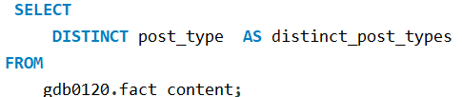
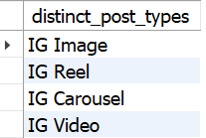
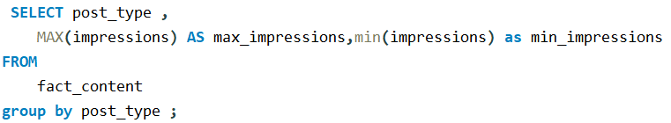
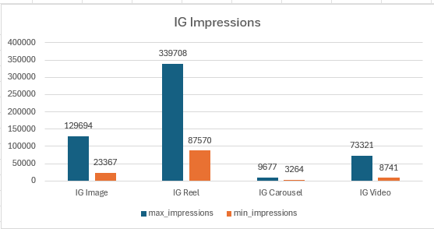
Unique Post Types in the Dataset
Max & Min Impressions by Post Type
Notes:
To start, I ran a query on the fact_content table to identify all the unique post types used. As you can see in the chart, we have a variety such as Photos, Videos, Reels, and Carousels. This helps us understand the types of media being published and sets the context for further engagement analysis. This query finds the highest and lowest impression values for each post type.reels has the highest impressions .

Slide 4
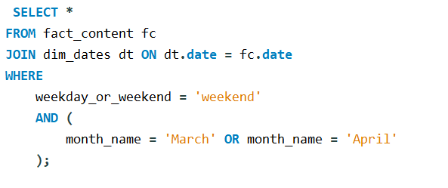
Weekend Posts in March & April
Notes:
the next qdhoc request was to analyse weekend engagement in march and April. I filtered all posts made on Saturdays and Sundays during March and April. After joining content table with dim_dates These were exported into a CSV for further review. This helps us plan future content around high-traffic weekends.

Slide 5
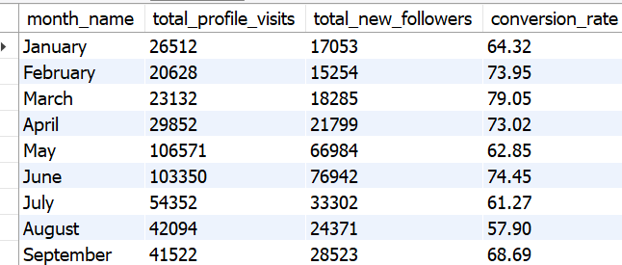
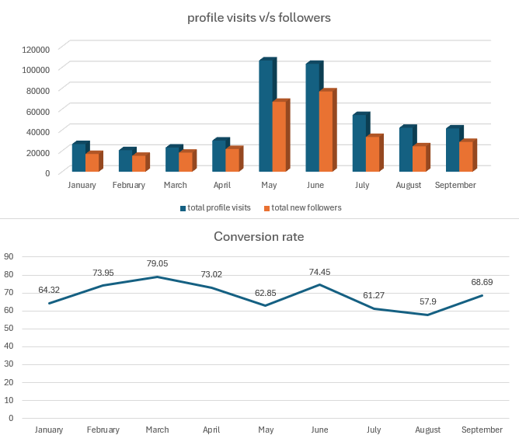
Monthly Stats – Profile Visits & New Followers
Notes:
This report summarizes monthly account metrics, including profile visits and new followers.may and June saw spikes in both, possibly due to promotions or campaigns. These trends help us correlate outreach with follower growth.

Slide 6
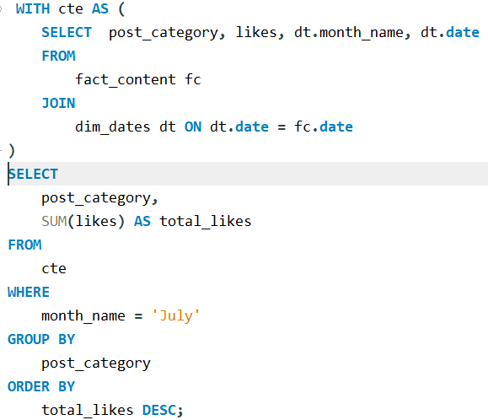
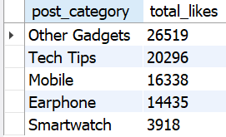
Likes by Post Category in July
Notes:
For July, I calculated total likes per post category. Other gadget, tech tips ' content performed best in terms of engagement. In terms of specific gadget mobile performed the best.we didn’t receive advance ddata regarding what a these other gadget are .This highlights categories that resonate with the audience. We can focus on introducing unique and catchy tech tips for more engagement . We can work on collaborations combine dwith tech tips kind of content as well.

Slide 7
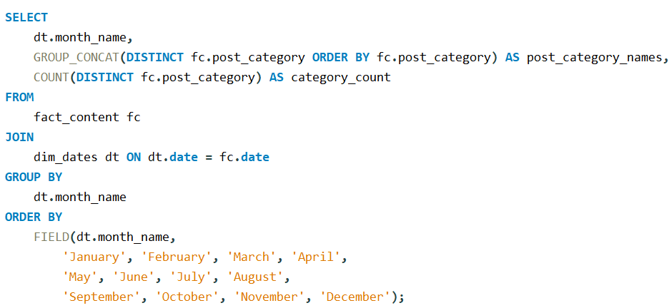
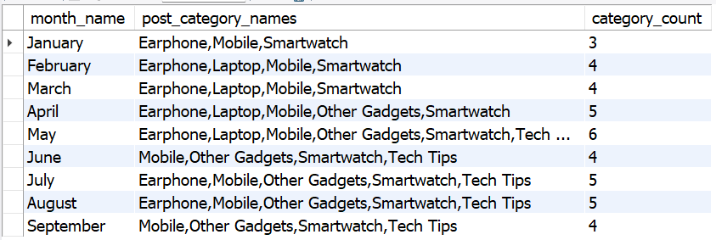
Monthly Post Category Distribution
Notes:
This table shows how many unique post categories were used each month. April had the highest diversity, suggesting more experimentation or campaign activity. Monitoring this helps ensure we cover all product lines consistently. i use group concat function to combine categories in one cell separated by comma

Slide 8
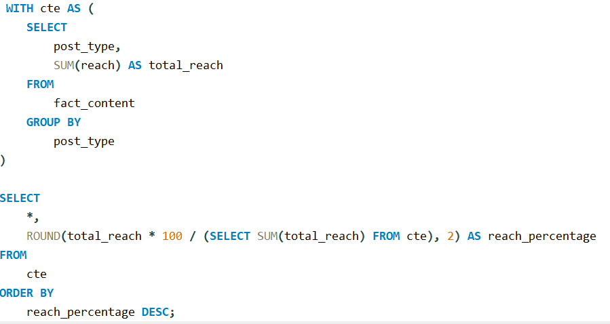
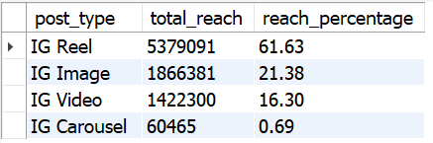
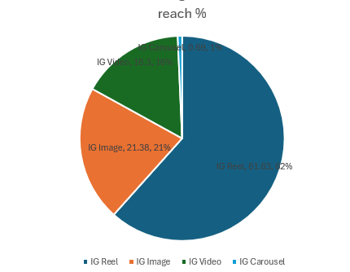
Reach Percentage by Post Type
Notes:
Here, I calculated the percentage of total reach by each post type. Reels contribute the majority of our reach, while image and video are less effective. This helps prioritize content types that maximize visibility.

Slide 9
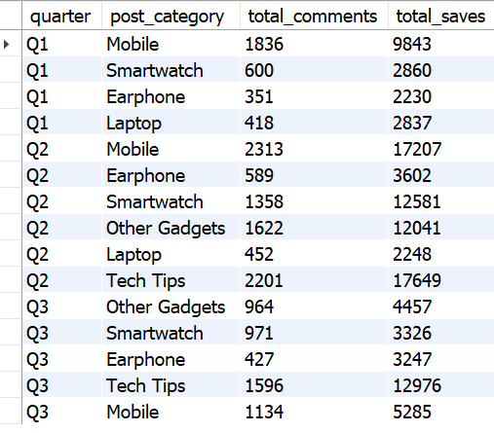
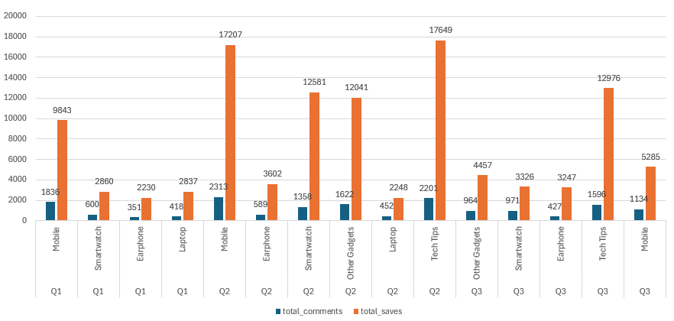
Comments & Saves by Quarter
Notes:
First I added a quarter column in dim_dates table using alter table command .This chart shows comments and saves by post category across quarters. For instance, ‘mobile and tech tips' content in Q2 had highest saves, suggesting strong interest. Understanding seasonality helps in campaign timing.

Slide 10
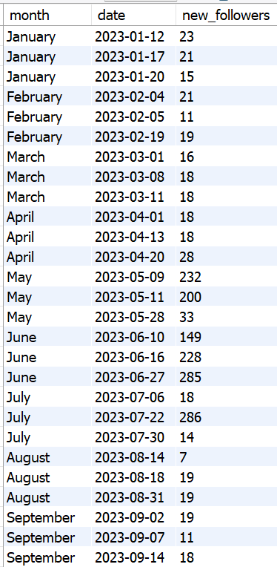
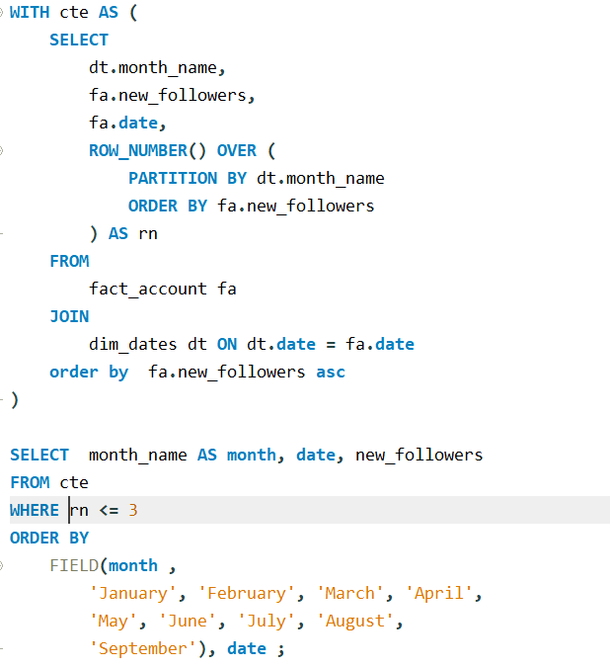
Top Dates for New Followers
Notes:
I ranked each month’s top 3 dates for new follower gains. This could correlate with specific posts, promotions, or external events. These dates offer a chance to reverse-engineer success

Slide 11
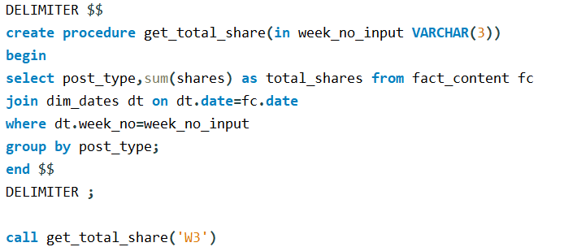
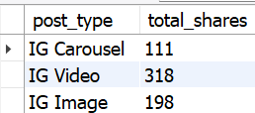
Weekly Post Type Share Report (Stored Procedure)
Notes:
I created a stored procedure to report total shares per post type for any given week. This modular approach lets us evaluate weekly performance consistently and track shareability over time.

Slide 12
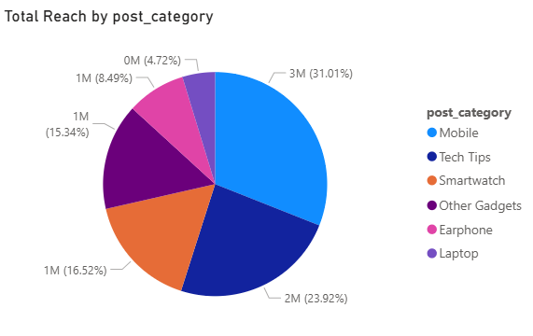
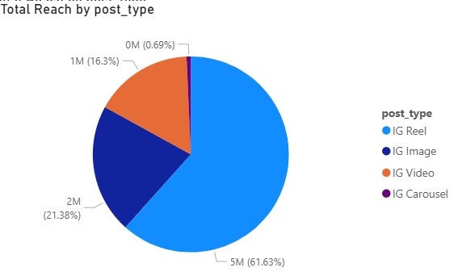
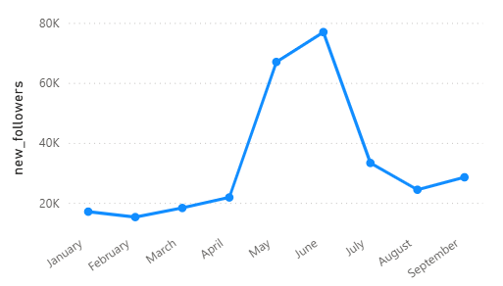
Notes:
this is the pie charts representing total reach by post_category and post_type..the bottom charts shows the growth of new followers over the monthsthis analysis was doen in power bi

Slide 13
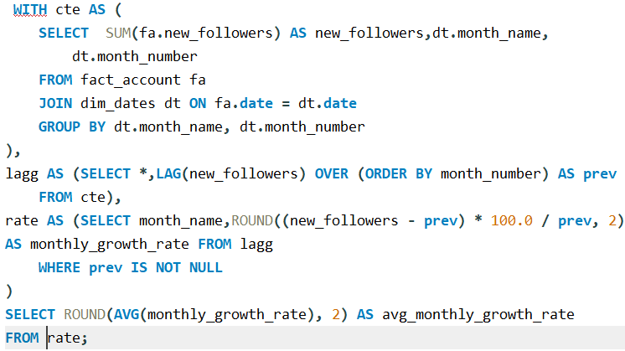
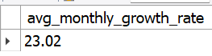
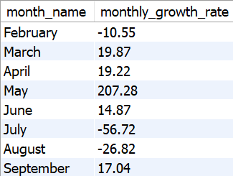
Average monthly growth rate
Notes:
Now let’s take a look at our average monthly growth rate.”“Over the past [9 months], and the data shows an average monthly growth rate of 23.02% . very positive for the page and if we go deeper this is,February and July showed negative MoM growth rate .if we hav edeepre data about the details of campaigns and collaborations done in these months, we can verify the reason for this negative growth rate.

Slide 14
Key Takeaways
Reels deliver the highest conversion from visits to followers
May & June saw peak engagement, driven by Tech Tips and Mobile content
A viral Reel on June 3rd about a mobile product led to followers > profile visits
Tech Tips + Mobile are the most effective content themes
Carousels underperform – need creative upgrades (animations/graphics)
Video length doesn’t impact reach significantly – format matters more
Videos contribute 16% of total reach, mostly driven by Reels
Notes:
Now that we've analyzed the data in detail, here are the key strategic insights.First, Reels are by far the strongest content type when it comes to converting viewers into followers. They offer the highest conversion rate among all formats.The months of May and June saw peak activity, with a surge in both profile visits and new followers. This coincided with a clear focus on Tech Tips and Mobile content, which performed equally well — indicating these are our most engaging themes.One specific highlight was a mobile-related Reel posted on June 3rd, which resulted in more followers than profile visits — a rare but powerful sign of viral content or strong word-of-mouth impact.From this, we can confidently say that Tech Tips and Mobile are our strongest content niches. They consistently deliver reach, engagement, and audience growth.On the other hand, carousel posts are underperforming. There’s an opportunity here to improve their impact by incorporating animations or interactive graphics to make them more engaging.Also worth noting: video duration doesn’t have a strong correlation with reach. So rather than focusing on video length, we should double down on the format and content value. Reels, even short ones, contribute to 16% of total reach.Strategically, the path forward is clear:We should invest more in Reels that blend Tech Tips and Mobile content. This approach maximizes engagement, strengthens our content niche, and positions us as a potential independent tech brand — not just a content page, but a valuable voice for users and partners alike.

Slide 15
Recommendations
Prioritize Reels focused on Tech Tips and Mobile to maximize engagement, brand value, and monetization potential
💰 Financial Opportunity
Higher engagement = better brand collaboration deals
Reels offer organic reach → reduced paid ad spend
Strong niche positioning → potential to build our own product line or affiliate brand
Boosted follower growth → increased influence valuation for long-term partnerships
Notes:
To bring this all together, our data shows that Instagram Reels in the Tech Tips and Mobile niche consistently outperform all other content types — not just in reach or engagement, but in actual conversions.This isn’t just a content strategy — it's a business opportunity.First, higher engagement and consistent follower growth attract better brand partnerships, often commanding higher rates in influencer or sponsorship deals.Second, Reels are cost-effective — they tap into Instagram’s organic algorithm, meaning less reliance on paid ads to reach a wider audience.Third, carving out a clear niche in tech gives us room to grow into affiliate partnerships, product reviews, or even launch our own branded digital products in the future — like guides, courses, or toolkits.By investing in this proven content strategy — Reels + Tech/Mobile — we’re not just growing a page.We're building a media asset with real commercial value and long-term potential.

